Slide 1
Entity Framework Core

Slide 2

Entity Framework Core (1)
Entity Framework Core is the new version of Entity Framework after EF 6.x:
open-source,
lightweight,
extensible
and a cross-platform version of Entity Framework
works on multiple operating systems like Windows, Mac, and Linux
an Object/Relational Mapping (ORM) framework
an enhancement to ADO.NET

Slide 3
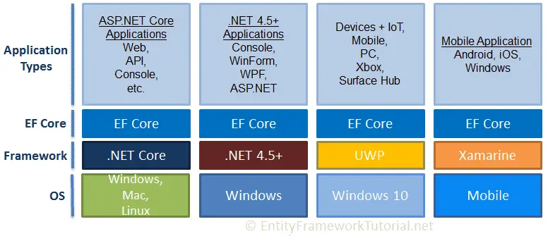
Entity Framework Core (2)
EF Core is intended to be used with .NET Core applications.
Can also be used with standard .NET 4.5+ framework based applications

Slide 4
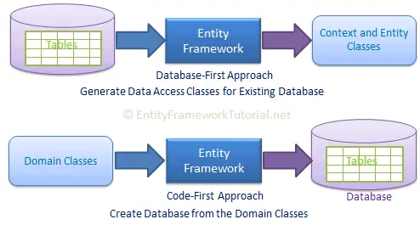
Development Approaches
EF Core supports two development approaches:
Code-First
Database-First
DB model is not supported as of EF Core.

Slide 5
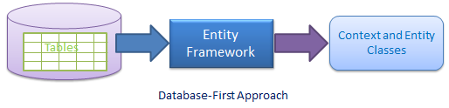
EF Core Database-First Approach
In the database-first development approach, you creates the domain and context classes based on your existing database using EF Core commands.
EF 6 supports the database-first approach extensively.
EF Core includes limited support for this approach.

Slide 6
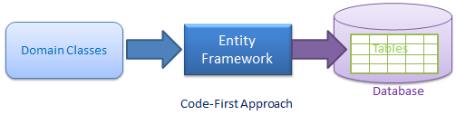
EF Core Code-First Approach
Use this approach when you do not have an existing database for your application.
start writing your entities (domain classes) and context class first
create the database from these classes using migration commands.
This approach is useful in Domain Driven Design (DDD).
Why do developers prefer this approach?

Slide 7
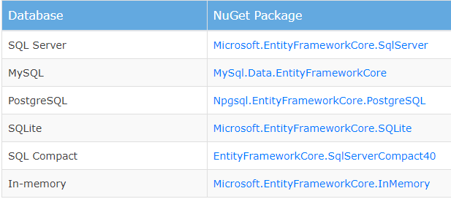
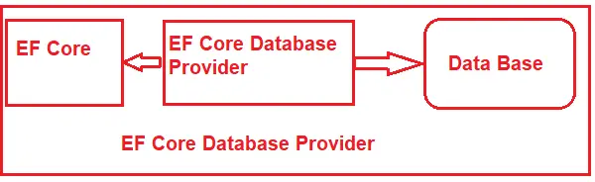
EF Core Database Providers
Entity Framework Core uses a provider model to access many different databases.
EF Core includes providers as NuGet packages which you need to install.
Oracle DB 11.2 onwards
Oracle.EntityFrameworkCore

Slide 8
EF Core vs EF 6 (1)
EF Core continues to support the same features and concepts as EF 6.
DbContext and DbSet
Data Model
Querying using Linq-to-Entities
Change Tracking
SaveChanges
Migrations

Slide 9
EF Core vs EF 6 (2)
Some features of EF 6 are not supported in EF Core, such as:
EDMX/ Graphical Visualization of Model
Entity Data Model Wizard (for DB-First approach)
ObjectContext API
Querying using Entity SQL.
Inheritance: Table per type (TPT)
Inheritance: Table per concrete class (TPC)
Entity Splitting
Spatial Data
Stored Procedure mapping with DbContext for CUD operation
Seed Data

Slide 10
EF Core vs EF 6 (3)
EF Core includes the following new features which are not supported in EF 6.x:
Easy Relationship Configuration
Batch INSERT, UPDATE, and DELETE operations
In-memory provider for testing
Support for IoC (Inversion of Control)
Unique Constraints
Shadow Properties
Alternate Keys
Global Query Filter
Field Mapping
DbContext Pooling
Better Patterns for Handling Disconnected Entity Graphs

Slide 11
Differences Between EF Core and EF6 (1)
Development Platform:
EF6: EF6 is a Windows-only framework within .NET, not compatible with other platforms.
EF Core: it is cross-platform and can be used in applications that run on Windows, Linux, and macOS.
Performance:
EF6: it has been criticized for its performance in certain scenarios, particularly when performing batch operations.
EF Core: it is a performance-focused framework, built from scratch. It’s generally considered to be faster and more efficient than EF6.

Slide 12
Differences Between EF Core and EF6 (2)
Features:
EF6: EF6 is an ORM Framework with advanced features. Initially, some features like Lazy Loading and Entity Graphs were not supported in EF, but they were added later.
EF Core: EF Core started with a smaller feature set of features but then it introduced many new features such as Global Query Filters and Shadow Properties, etc.
Database Providers:
EF6: Although EF6 supports multiple database providers, integrating third-party providers can be a challenge.
EF Core: EF Core has been designed to support various databases, including NoSQL databases, with a more flexible provider model. You can easily integrate third-party providers.

Slide 13
Differences Between EF Core and EF6 (3)
Configuration:
EF6: configuration can be done using either a code-based or XML-based (in .config files) approach.
EF Core: EF Core uses code-based configuration instead of XML-based configurations. The .NET Core philosophy is to move away from XML-based configurations.
Community and Future:
EF6: Although EF6 is still maintained and receives updates, the primary focus of the EF team and community is on EF Core.
EF Core: EF Core is the future of Entity Framework. It receives regular updates, new features, and performance improvements.

Slide 14
EF Core Components

Slide 15
DbContext, DbSet
DbContext:
The DbContext class is the main entry point for interacting with the database in EF Core.
It represents a session with the database and provides a set of methods for querying, inserting, updating, and deleting entities.
DbSet:
The DbSet class represents a collection of entities of a specific type in the context.
It provides methods for querying and manipulating entities in the database.

Slide 16
Entity, Migration, LINQ
Entity:
An entity is a class that represents a table in the database. Each property of the entity class corresponds to a column in the table.
Entities can have relationships with other entities, which are defined using navigation properties.
Migration:
Migrations are used to manage changes to the database schema over time.
Allow create, update, and revert database schema changes using code-first approach.
Migrations are created based on the changes made to the entity classes.
LINQ Queries:
EF Core supports LINQ (Language Integrated Query) for querying the database.
Use LINQ queries to retrieve data from the database using a familiar syntax.

Slide 17
Change Tracking, Database Providers
Change Tracking:
EF Core tracks changes made to entities and automatically generates the necessary SQL statements to persist those changes to the database.
This includes tracking changes to properties, relationships, and navigation properties.
Database Providers:
EF Core supports multiple database providers, such as SQL Server, MySQL, PostgreSQL, SQLite, and more.
Each provider has its own NuGet package that needs to be installed to work with that specific database system.

Slide 18
Install Entity Framework Core (Demo)

Slide 19
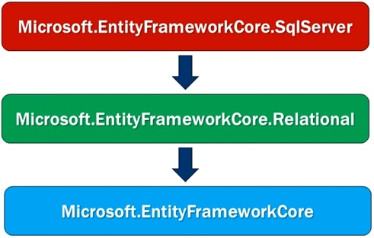
install NuGet Package
In order to use SQL Database with EF Core, we need to install its NuGet Package

Slide 20

Thank you

